Slide 1
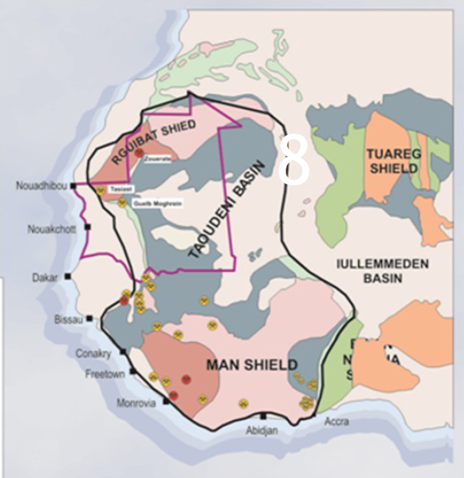
Mauritania Mining Ventures Project
Aries Aviation Services Ltd and IDM Industries Ltd (Aries/IDM), under an exclusive agreement with the Ministry of Petroleum, Energy and Mines (MPEM) in Mauritania, will promote minerals exploration and mining opportunities in Mauritania. Utilizing subsidiary company APG Airborne Surveys (APG) for all remote sensing activities in Mauritania, the group will compile all legacy geophysical/geological data and have an aircraft located in-country to acquire, process, integrate, interpret and market new geophysical surveys to aid current mining companies and to encourage new investors to enter Mauritania.
New airborne and/or ground based surveys for technical data will be completed on a MultiClient or Proprietary basis. Survey types to include magnetics, radiometric, electromagnetics, airborne full tensor gravity gradiometer (FTG) data, seismic data, hyperspectral and LIDAR data.
Project Website
A specific and comprehensive Mauritania Mining Ventures and Opportunities Website is being developed by APG for the MPEM to be used to promote) the opportunities and market data available for mining exploration and exploitation in Mauritania to include:
- most important mineral types known for exploration/production: iron-ore, gold (production), copper, uranium, diamonds, lithium,
- technical data available: geophysics, geochemistry, satellite, mapping, cores, drilling
- concessions available with available data
- permit application procedures and work program requirements and financial qualifications
- mining code
Onshore Hydrogen Exploration
APG will also be working with seismic company Tricon Geophysical Inc. who has signed an agreement with the MPEM to promote natural hydrogen exploration onshore Mauritania. The airborne data to be acquired by APG (magnetics and radiometrics) are key technologies for finding rock types, terrains and structures important for hydrogen generation and trapping.
MAURITANIA MINING VENTURES & OPPORTUNITIES WEBPAGE LINK:

Slide 2
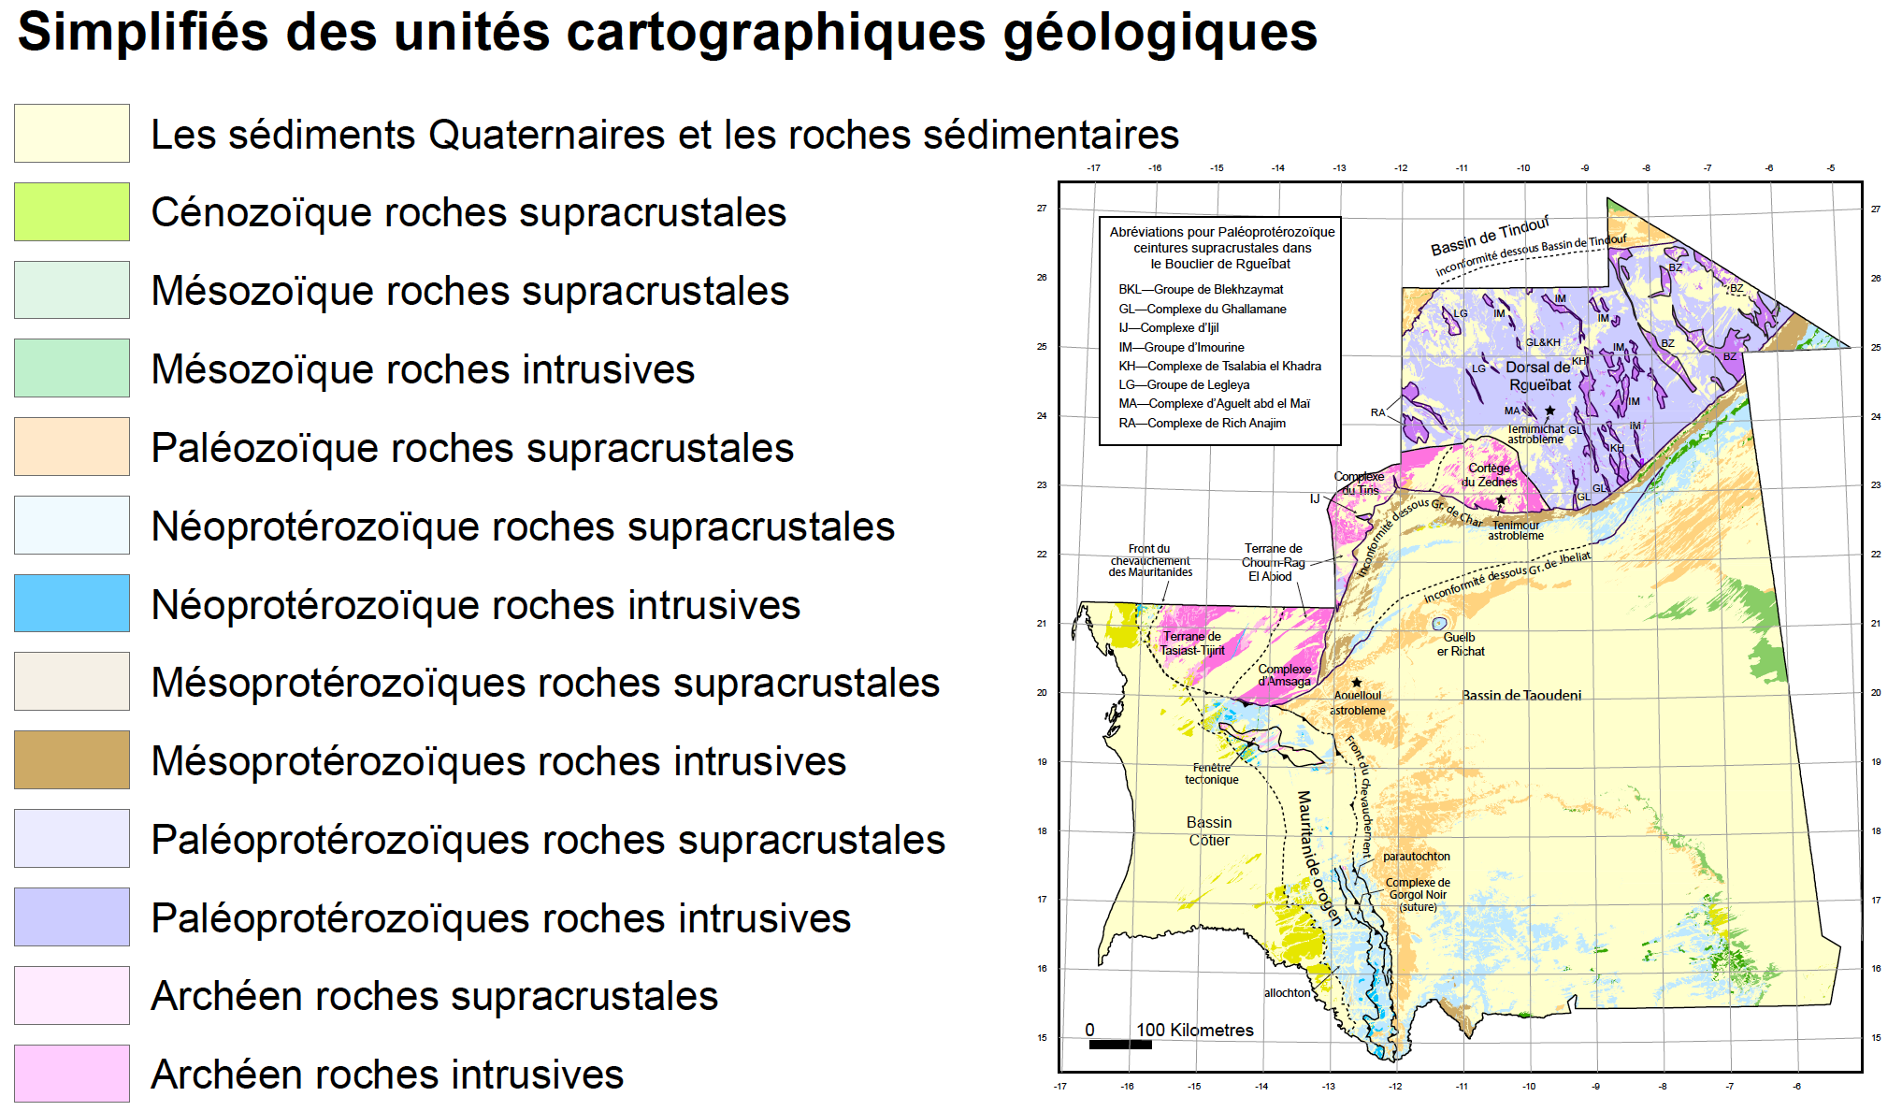
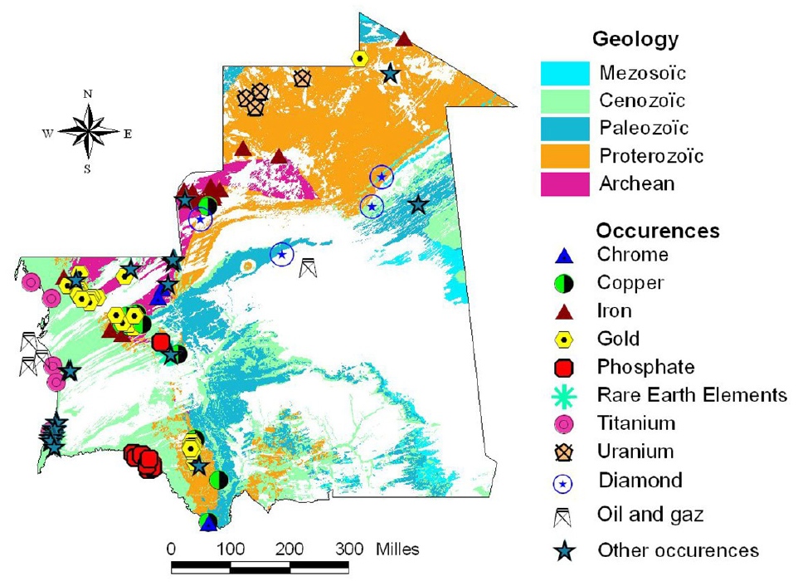
Mauritania Mining Ventures Project

Slide 3
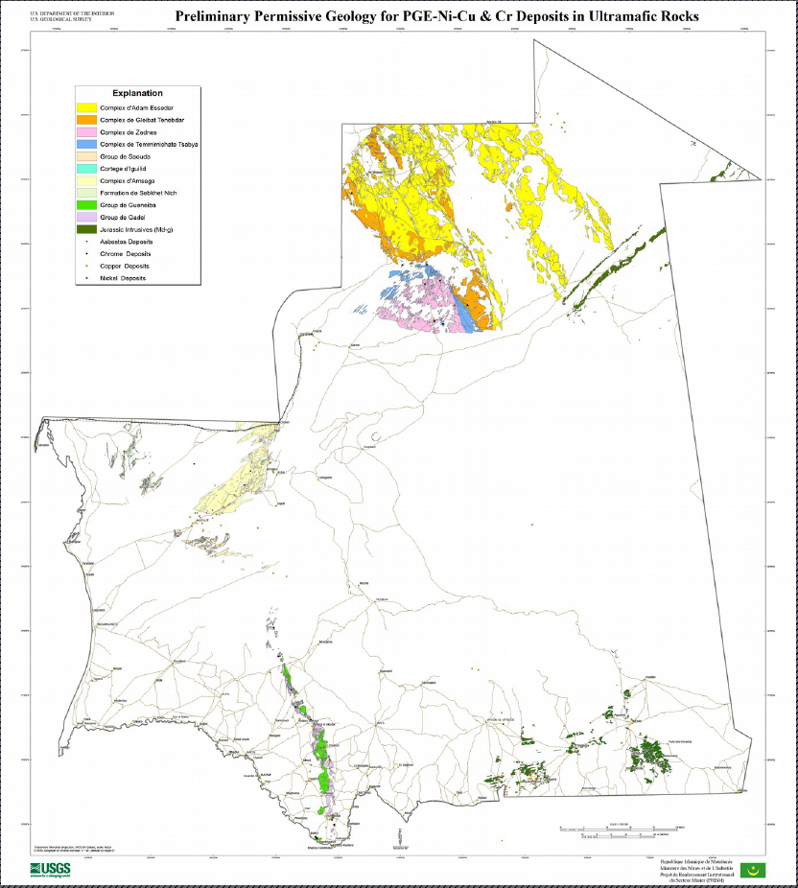
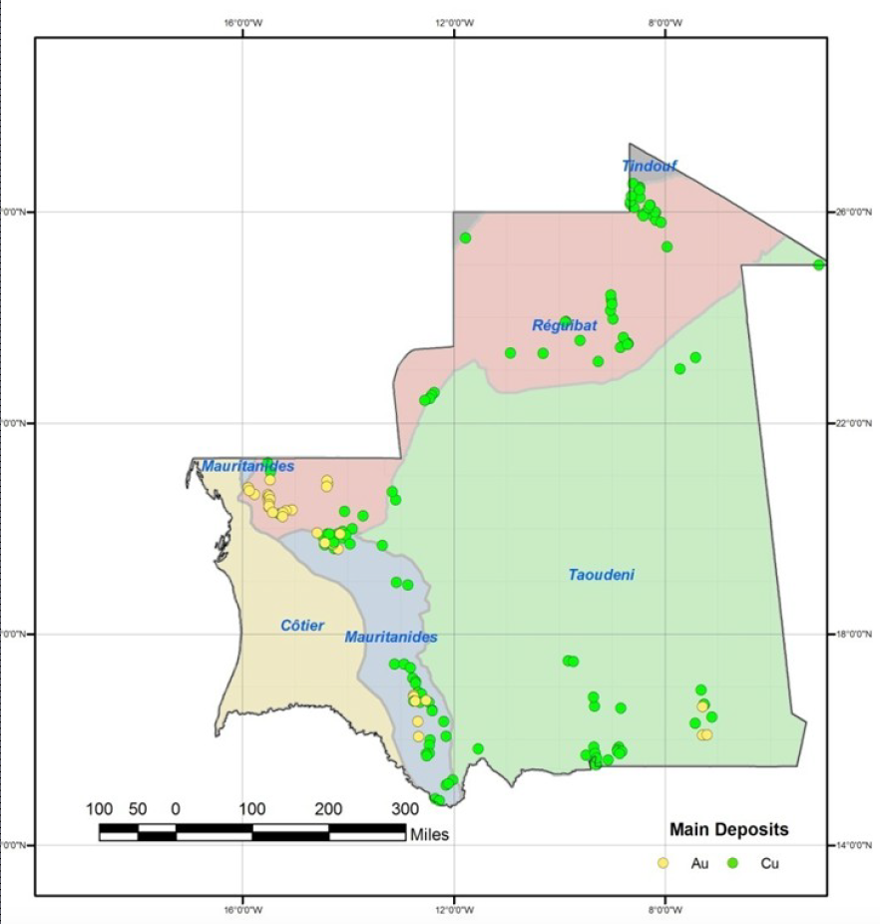
Mauritania Mining Ventures Project

